Slide 1
How did Australia break the world record for economic growth
by the skeptics

Slide 2
Who Are our audience?
Department of Treasury for advice on preparing the Australian Government Budget.
Investors in the Australian Stock Exchange Top 50 companies.
General audience who have interest in the economic progress of the nation.

Slide 3
Research Questions
MAIN ISSUE: It has now been 107 quarters since Australia had a technical recession, defined as two consecutive quarters of negative economic growth.
Supplementary Questions:
What are the main factors that contribute to GDP in Australia ?
What factors would heavily affect how the GDP changes in future years?
Does unemployment rate affect GDP?
Does increase in GDP lead to increase in ASX50 stock prices?
How does interest rate changes affect GDP?
Notes:
We all know that Australia has experienced an era of unprecedented economic prosperity over the last 26 years, avoiding recessions when the rest of the world did not
As Commonwealth Government Ministers, you are responsible for making laws and decisions that affect the country, including the economy
As the current world record holders for continued economic growth what do you need to do to continue the uninterrupted economic growth

Slide 4
How do you measure the economy
The most common way to measure the economy is Gross Domestic Product or GDP
GDP is the total value of everything - goods and services - produced in our economy
GDP is measured on a quarterly basis (or every 3 months)
Economic growth occurs when GDP increases between quarters (e.g. Q2 > Q1)
It has now been 107 quarters since Australia had a technical recession
Australia currently holds the world record for continued economic growth

Slide 5
GDP percentage change between quarters between 1980 and 2017
Notes:
Mild recessions have been occurring with greater frequency over the past 10 years than they did in the 1990s, when we began the decade with a deep recession, then enjoyed a low-inflation, high productivity
boom. The scrappier record since 2000 may be a reflection of the increased volatility in the world
economy, or lack of structural economic reform since the GST was bedded down, or a combination of both.
The economic debate would be better served with a little more perspective. Recessions are a normal part of the
business cycle. They will never be eliminated; the trick for policy-makers is to avoid the crash landings that lead to
mass retrenchments, and we haven't had one of those in 20 years.

Slide 6
Different methods for calculating gDP
The Income Approach (GDP = π + wl + rk)
The Production Approach
The Expenditure Approach (GDP = C + I + G +NX)
The income approach is when you add together all factor payments.
The production approach is where you add up the total value of all goods produced in the economy.
The expenditure approach is where you add up all the various types of spending which occurs within an economy..

Slide 7
What are the variables that affect GDP
Model 1 looks at the Expenditure Approach (GDP = C + I + G + X)
Model 2 looks at the indicators for the components of the Expenditure Approach e.g. using CPI and Sales as indicators instead of Consumption
Model 3 takes into consideration other available data sources, not limited to the model e.g. population of Australia

Slide 8
Models
Model 1
G
X
C
I
Model 2
CPI
Expense
HDI
Sales
Interest
jobs
trade
rates
Model 3
?
?
?
?
?
?
?
?
?
?
?
?

Slide 9
Model 1
GDP = Consumption(C) + Investment(I) + Government Spending (G) + Net Exports (X)

Slide 10
Model 1

Slide 11
Model 2
Data Sources for Model 2:
Gross Domestic Product, Population & Unemployment – data sourced from The Organisation for Economic Co-operation and Development (OECD).
Human Development Index – data sourced from the United Nations Development Programme (UNDP).
Interest Rates & Exchange Rates – data sourced from the Reserve Bank of Australia (RBA).
Australian Stock Exchange (ASX50)- data sourced from Market Index.
Consumer Price Index(CPI), Sales, Expenditure, Labour Force & Balance on Goods and Services- data sourced from Australian Bureau of Statistics (ABS).

Slide 12
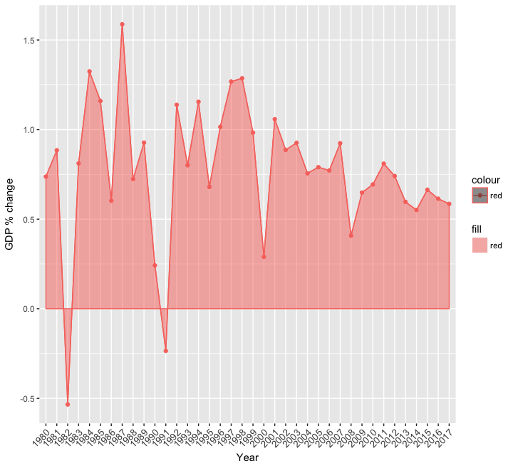
How GDP changed over the years?
There are large fluctuations in GDP till the year 2001. There are heavy drops in % in the year 1982 and year 1991. This indicates there has been recession that lead to such heavy drop. https://www.theaustralian.com.au/national-affairs/opinion/the-recessions-we-didnt-know-we-had/news-story/761f62646a3c251d3ce9cfae5a751e85?sv=955da03ee827960370e61fd9d8e0f27b
The economy has been more stable from the year 2001 with a drop of 0.5% during the 2008 financial crisis when there was minimal impact on Australia.
Economic growth peaked in the year 1987.

Slide 13
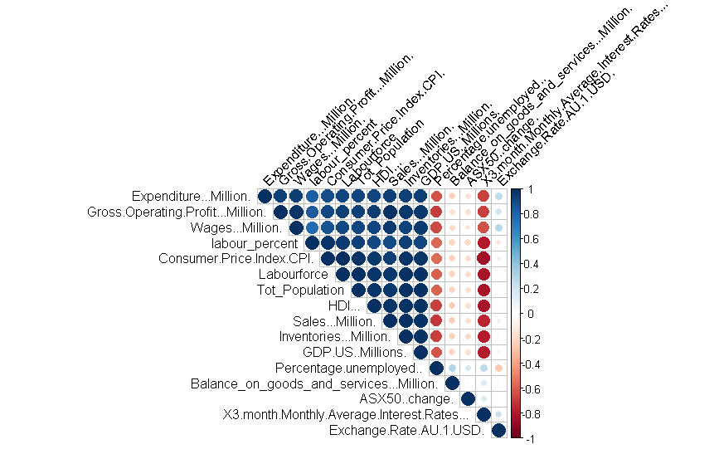
Correlation plot
The dark blue shades indicate strong positive correlation and red shades indicate negative correlation.
The plot shows that GDP is positively correlated with most of the factors.
It is negatively correlated with Unemployment and Interest rates.
Balance on goods and Services and Exchange Rates does not affect GDP.
Notes:
Interesting thing to note is predictors are related to one another.

Slide 14
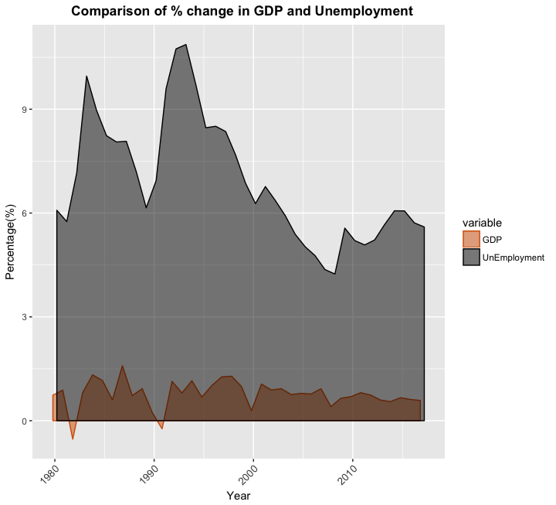
Does unemployment Rate affect GDP?
Considering the past 37 years, Unemployment was high during years 1983 and 1992. We can justify that it was the after-effects of 1982,1991 recession.
Correlation test value of -0.63 suggests that Unemployment negatively affects GDP.
This suggests government needs to spend more on creating jobs and employment to maintain a healthy economy.

Slide 15
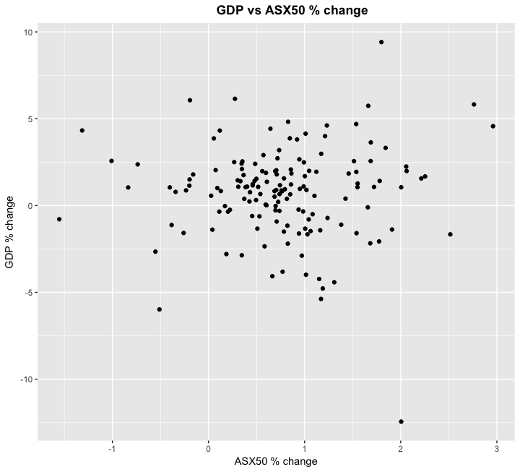
Is there relationship between ASX50 stock prices and GDP?
Moto:
Promoting these companies lead to increase in GDP?
If there is a relationship GDP increase as Stock Prices increase and GDP decrease as Stock Prices decrease.
The plot shows no relationship between the two.
Correlation value of 0.03 confirmed there is no relationship.

Slide 16
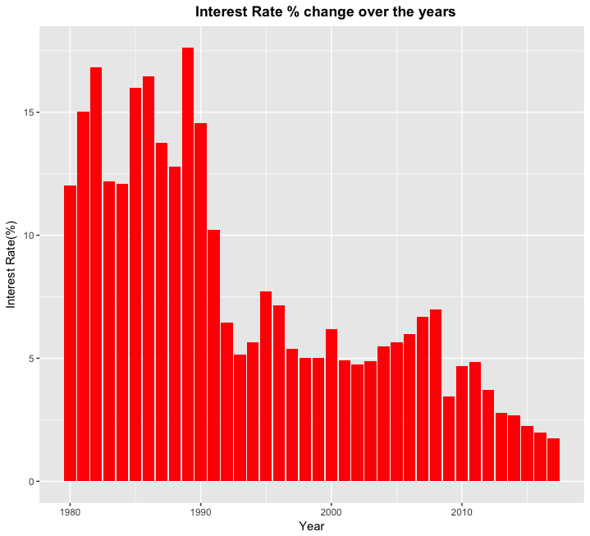
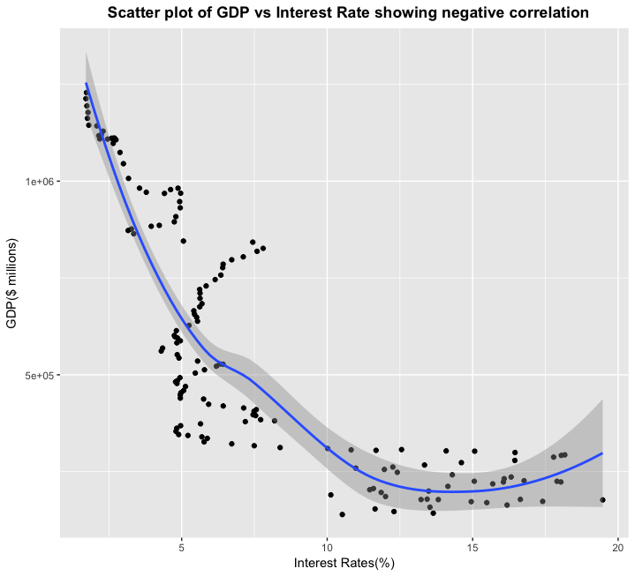
Interest rate and GDP
Notes:
The interest rate seems to have decreased over the years.
The scatter plot shows negative correlation between Interest Rate and GDP.
The correlation value calculated was -0.79 indicating as interest rates increase GDP decreases. So, it would be appropriate for governments to reduce the interest rates for goods and services for witnessing economic growth.

Slide 17
Model 2 –Feature Selection and Predictive modelling
Since the predictors are related to one another some features had to be dropped for modelling. So appropriate techniques where incorporated.
Models:
Multiple linear regression with forward feature selection.
Lasso regression.
Principal component regression.
Partial least squares regression.

Slide 18
Model validation
The data was partitioned into training and test set.
Regression models were trained on the training set.
Partial Least Squares regression gave the best estimates followed by Lasso regression. The error estimates only differed by a margin.
However, Lasso regression model was picked for its interpretability.
The model will be used to make prediction for future data.
Notes:
PLS and Lasso only differed by a certain margin.

Slide 19
Model 3
With Model 3 we intend to utilise our findings from Model 1 and Model 2 to build a better predictive model of factors that affect GDP
As experts in the field of economics, are there any other factors that you would suggest we look into that we have not covered in Model 1 or Model 2.

Slide 20
Limitations of the study
GDP prediction is usually complex and involves a lot of variables. Though the variables we hand picked for the model are most commonly used there is no guarantee that they are the best measures.
The data was initially collected from year 1970-2017. There was missing values in some factors till the year 1990. Imputation technique was used to replace missing values with stimulated data.
To minimize the impact of imputation we had to strip 10 years of data. The data we used is from 1980-2017.

